Slide 1
MLFSOM Simulations Homogeneous Beam

Slide 2
MLFSOM input parameters
Crystal & Exp. Params
Protein | Tetragonal lyosyzme
PDB code | 1H87
Unit cell | 77.25, 77.25, 38.66
Detector | Pilatus 6M
Mosaicity (initial-final) | 0.05 – 1.00º
B-factor (initial-final) | 14.8 – 51.8 A²
Fractional unit cell change | 1% (at the end)
Initial resolution | 1.5 A
Crystal size | 77.8 micron
Oscillation (stills) | 0.01º
Number of frames | 30
Beam Params
Beam size | 100 micron
Crystal size | 77.8 micron
Wavelength | 1.0 A
Beam dispersion | 0.00014
Beam divergence (hor, ver) | (0.06º, 0.01º)
Exposure per frame | 0.5 sec
Beam flux | 8.4 x 10¹⁰ ph/sec

Slide 3
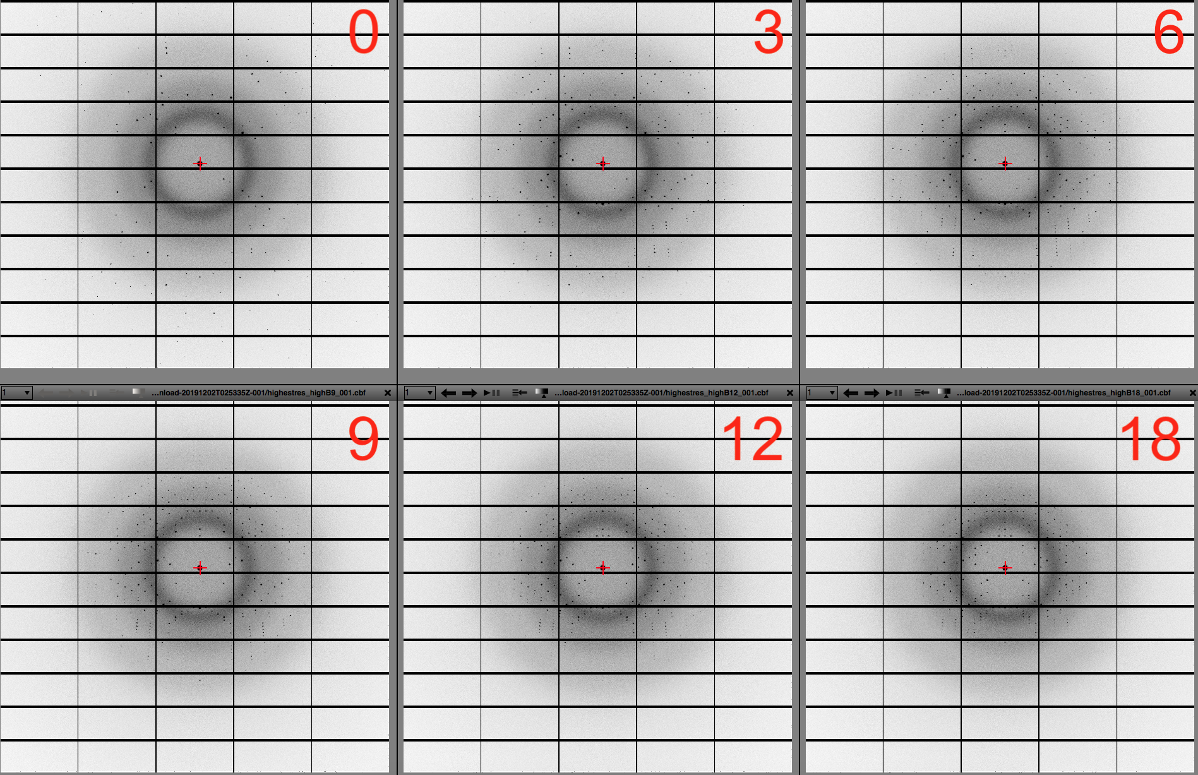
MLFSOM raw diffraction images

Slide 4
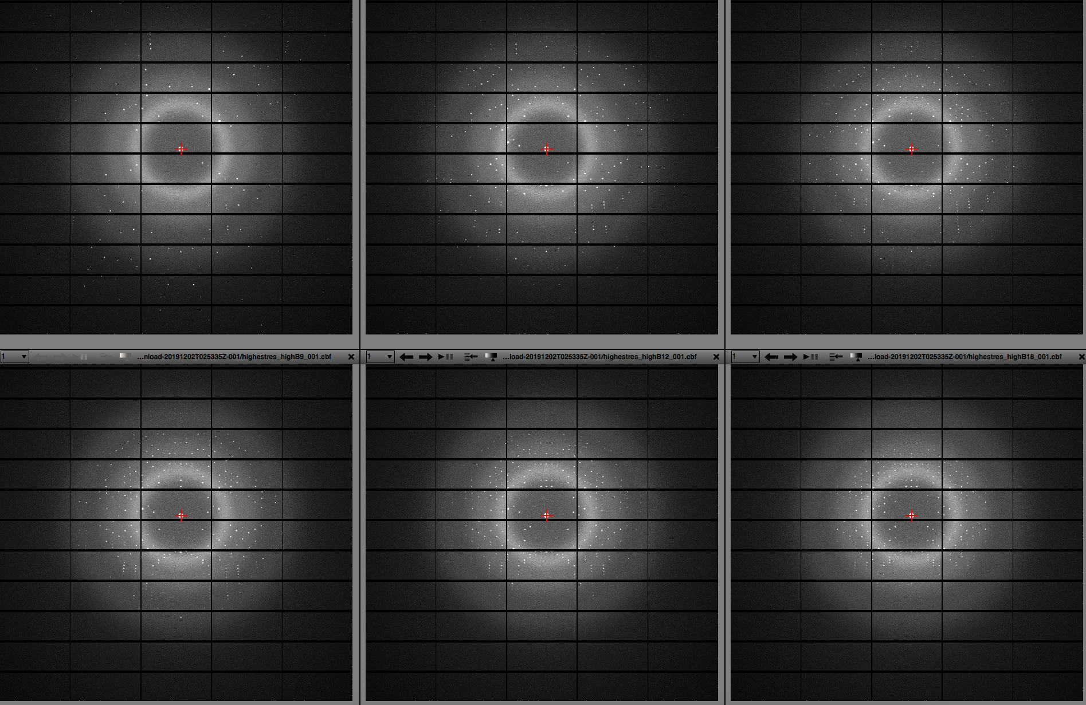

Slide 5
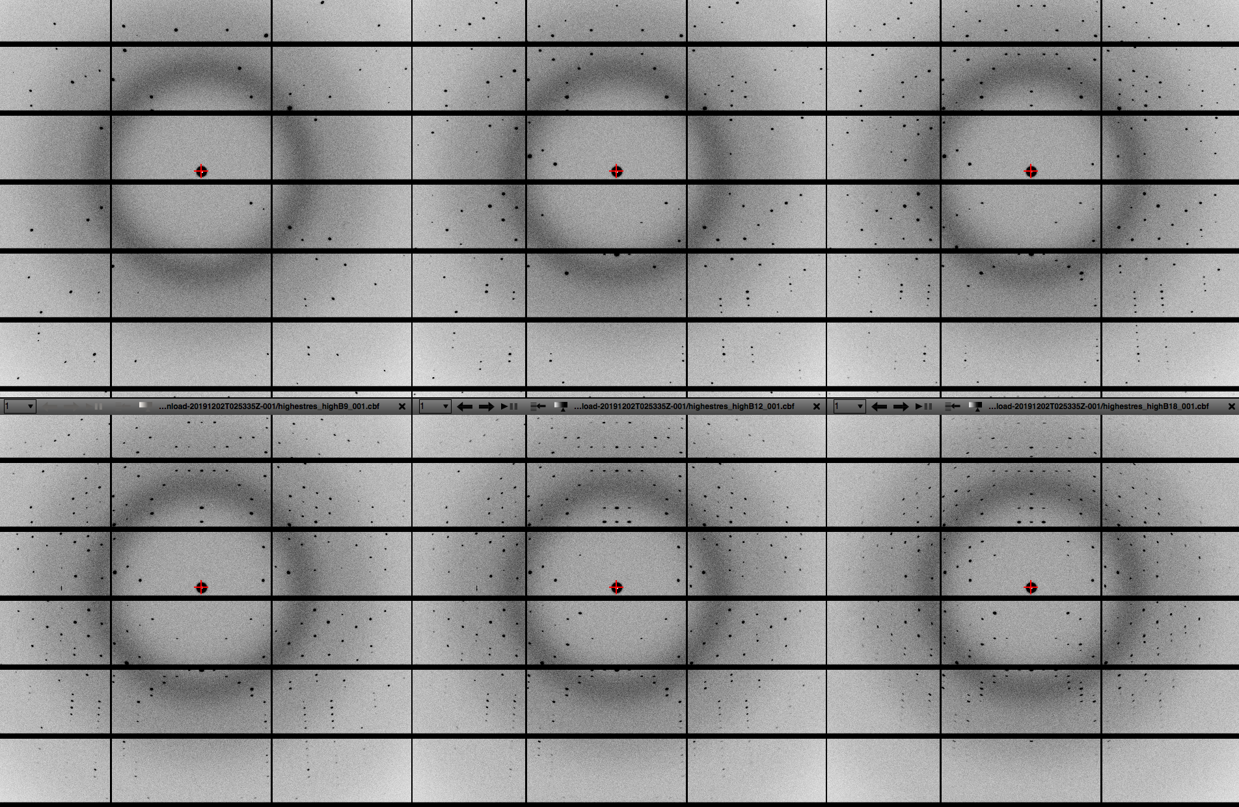

Slide 6
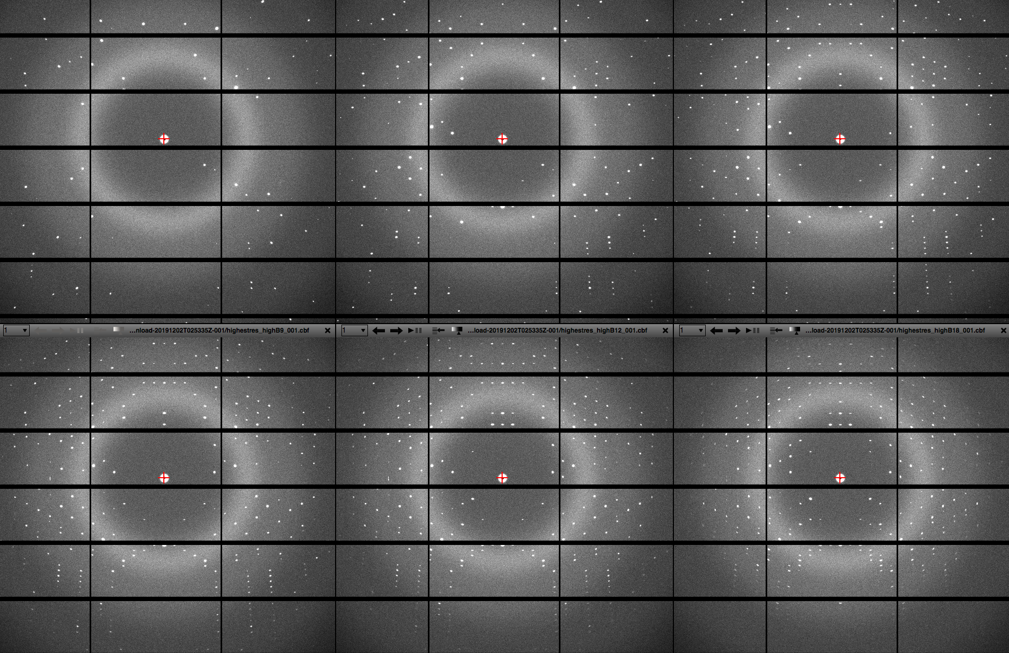

Slide 7
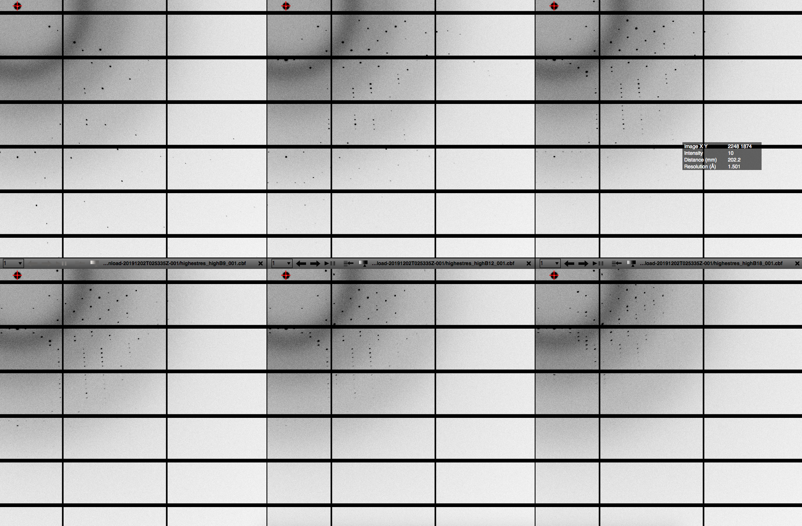

Slide 8
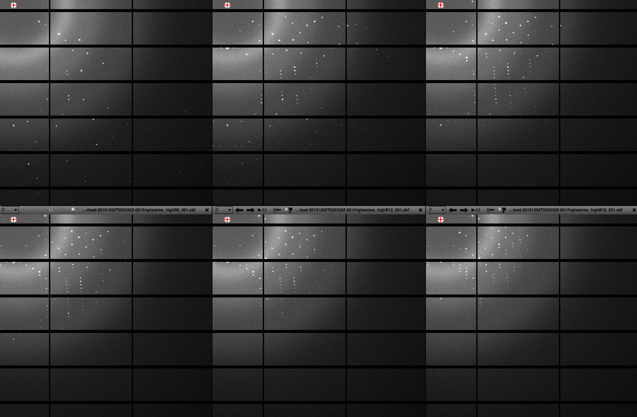

Slide 9
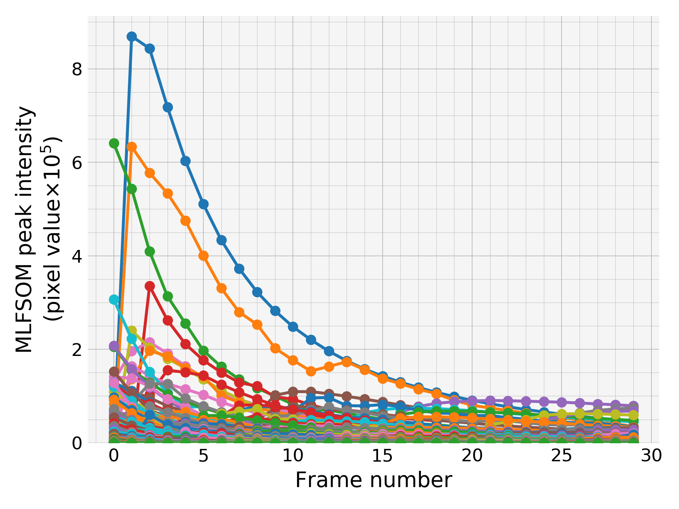
Evolution of peak intensities:
all peaks
There are many peaks that do not show up at the beginning but appear in the middle of the run.
Number of peaks substantially increase from the first to the second and third frame

Slide 10
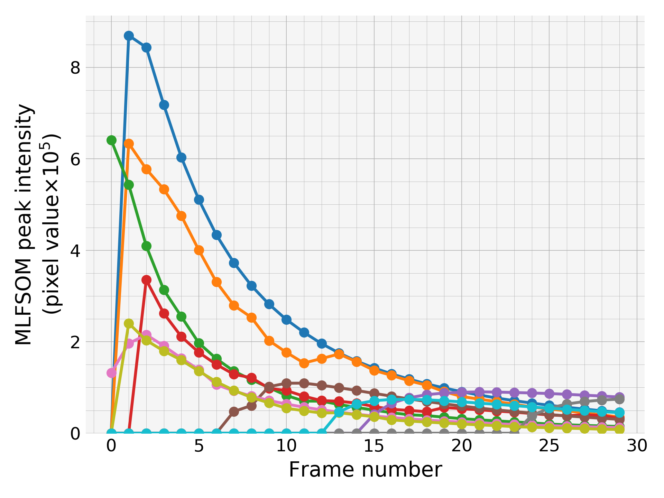
Evolution of peak intensities:
strongest 1o peaks
The brightest first 10 peaks (peaks are sorted by their average intensities over all frames)

Slide 11
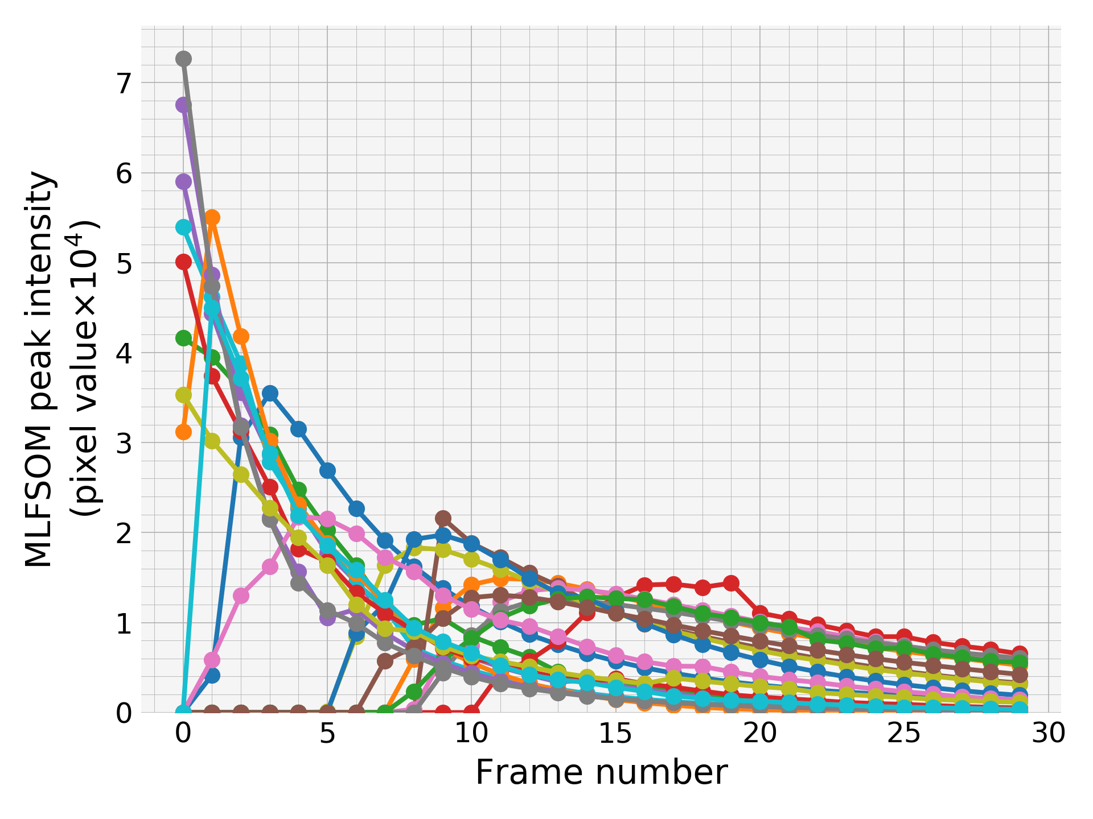
Evolution of peak intensities:
moderate-strong 2o peaks

Slide 12
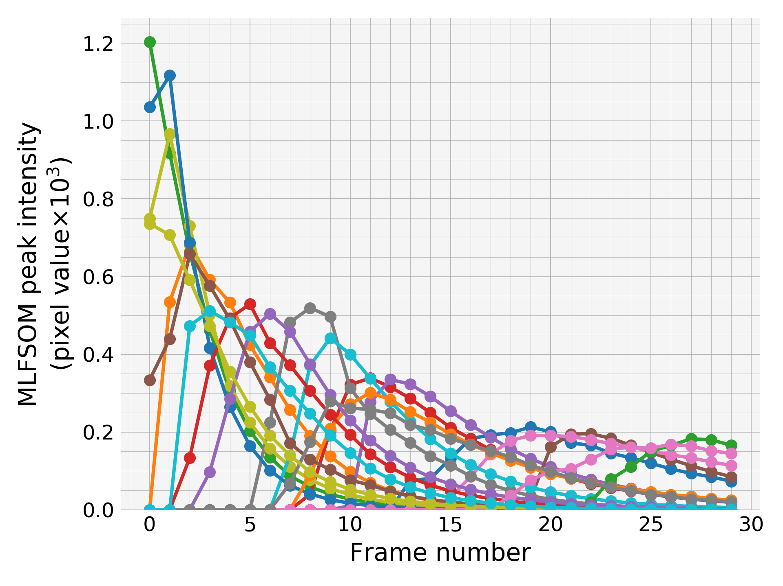
Evolution of peak intensities:
moderate 2o peaks

Slide 13
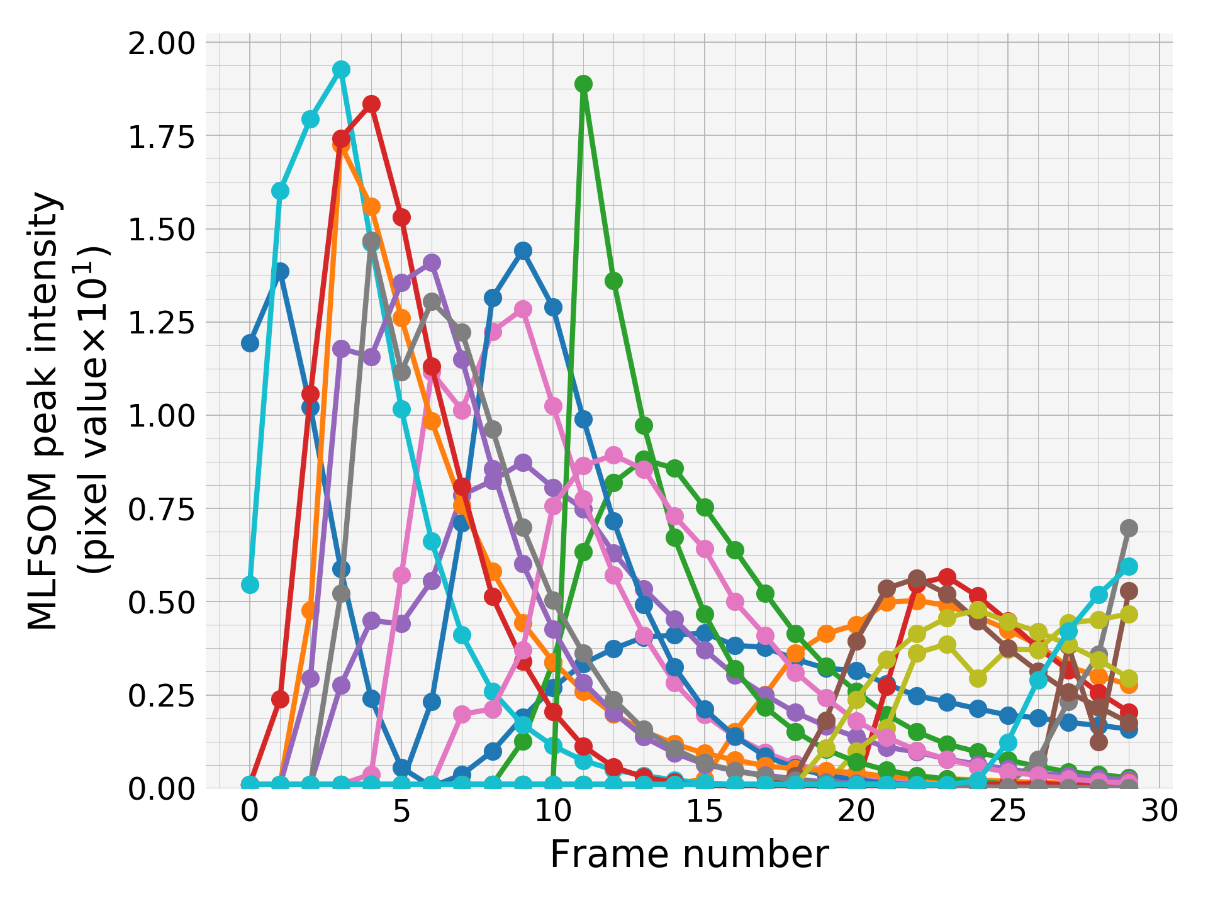
Evolution of peak intensities:
weak 2o peaks

Slide 14
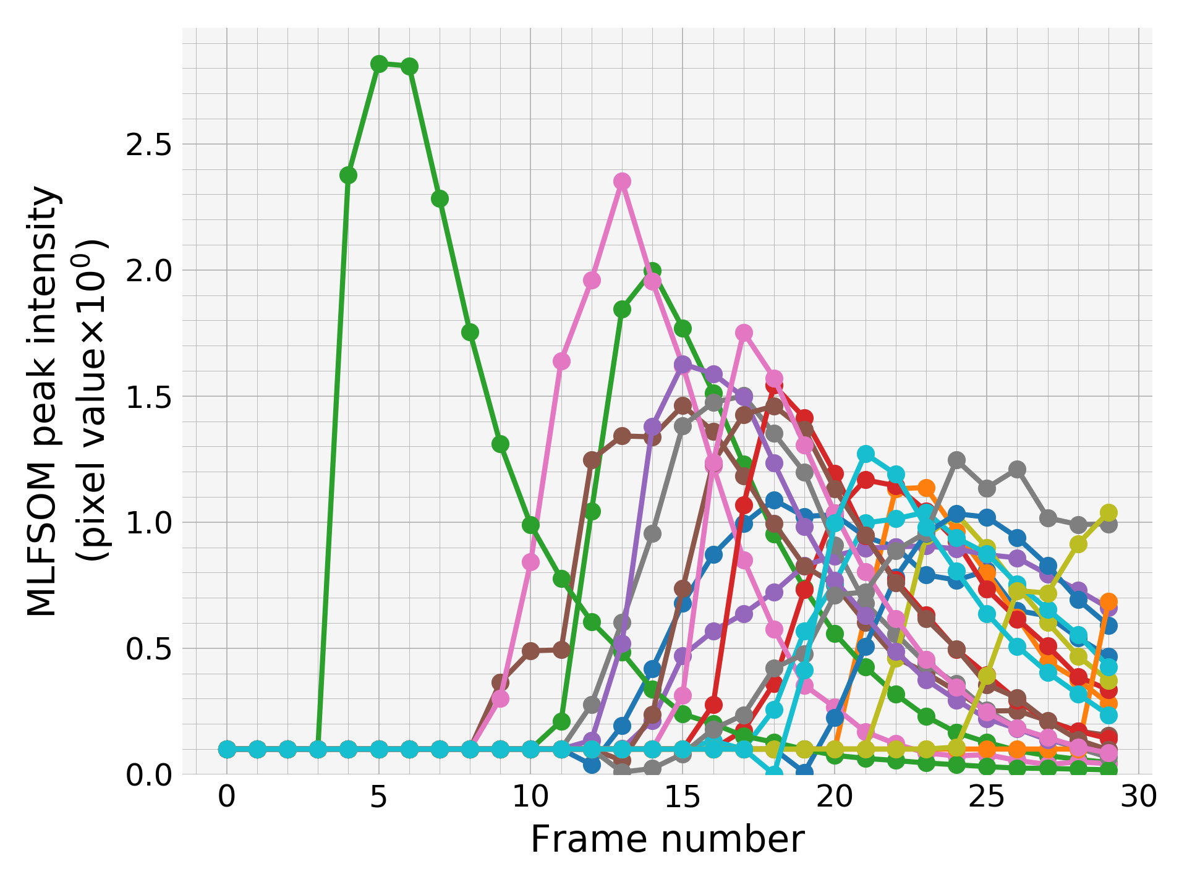
Evolution of peak intensities:
the weakest 2o peaks

Slide 15
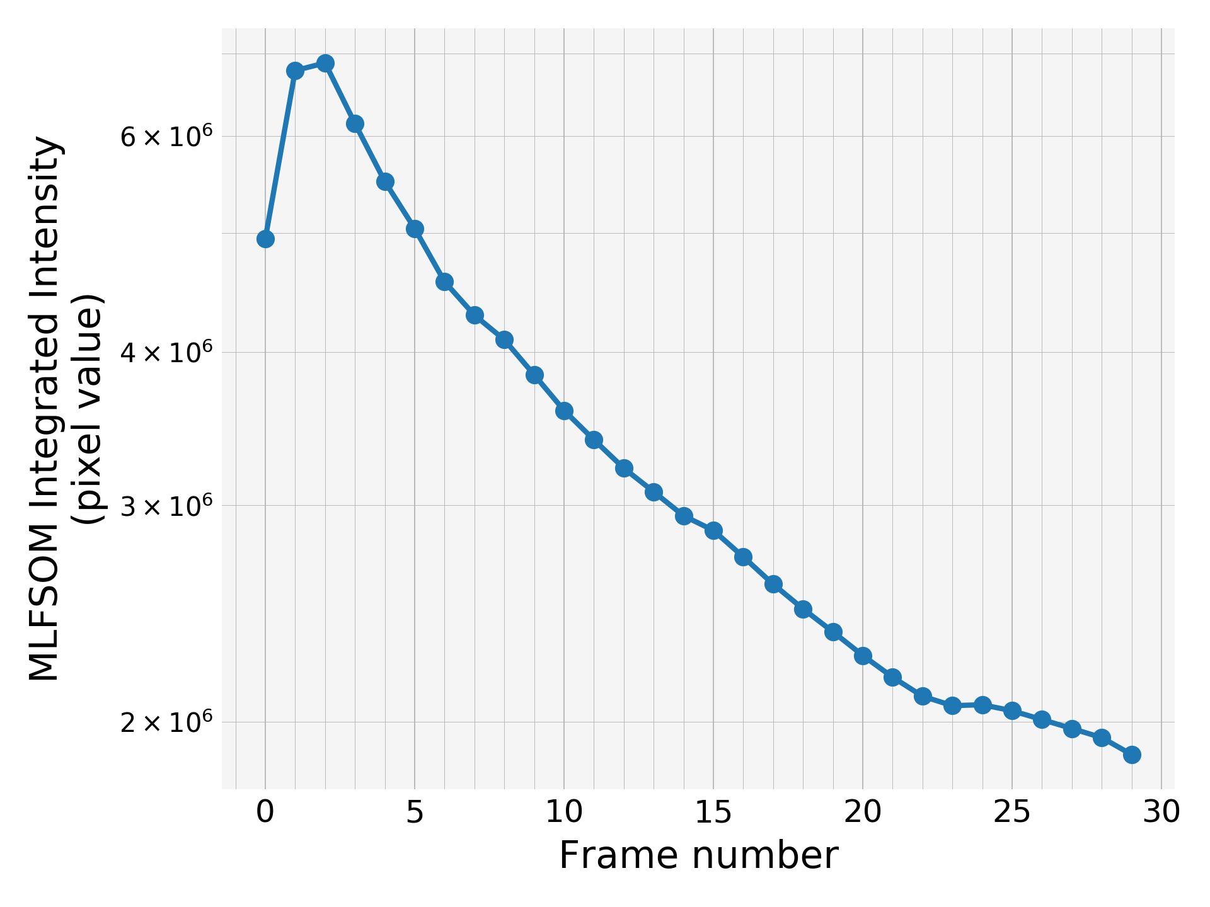
Integrated intensity
Initial increase in the intensity is obvious. It was already so obvious from the dramatic increase in the number of total peaks from very first frame to the second or third frame
Integrated intensity does not drop much despite the dramatic increase in mosaicity from 0.05 to 1.00 and dramatic increase in B-factor from 15 to 55.

Slide 16
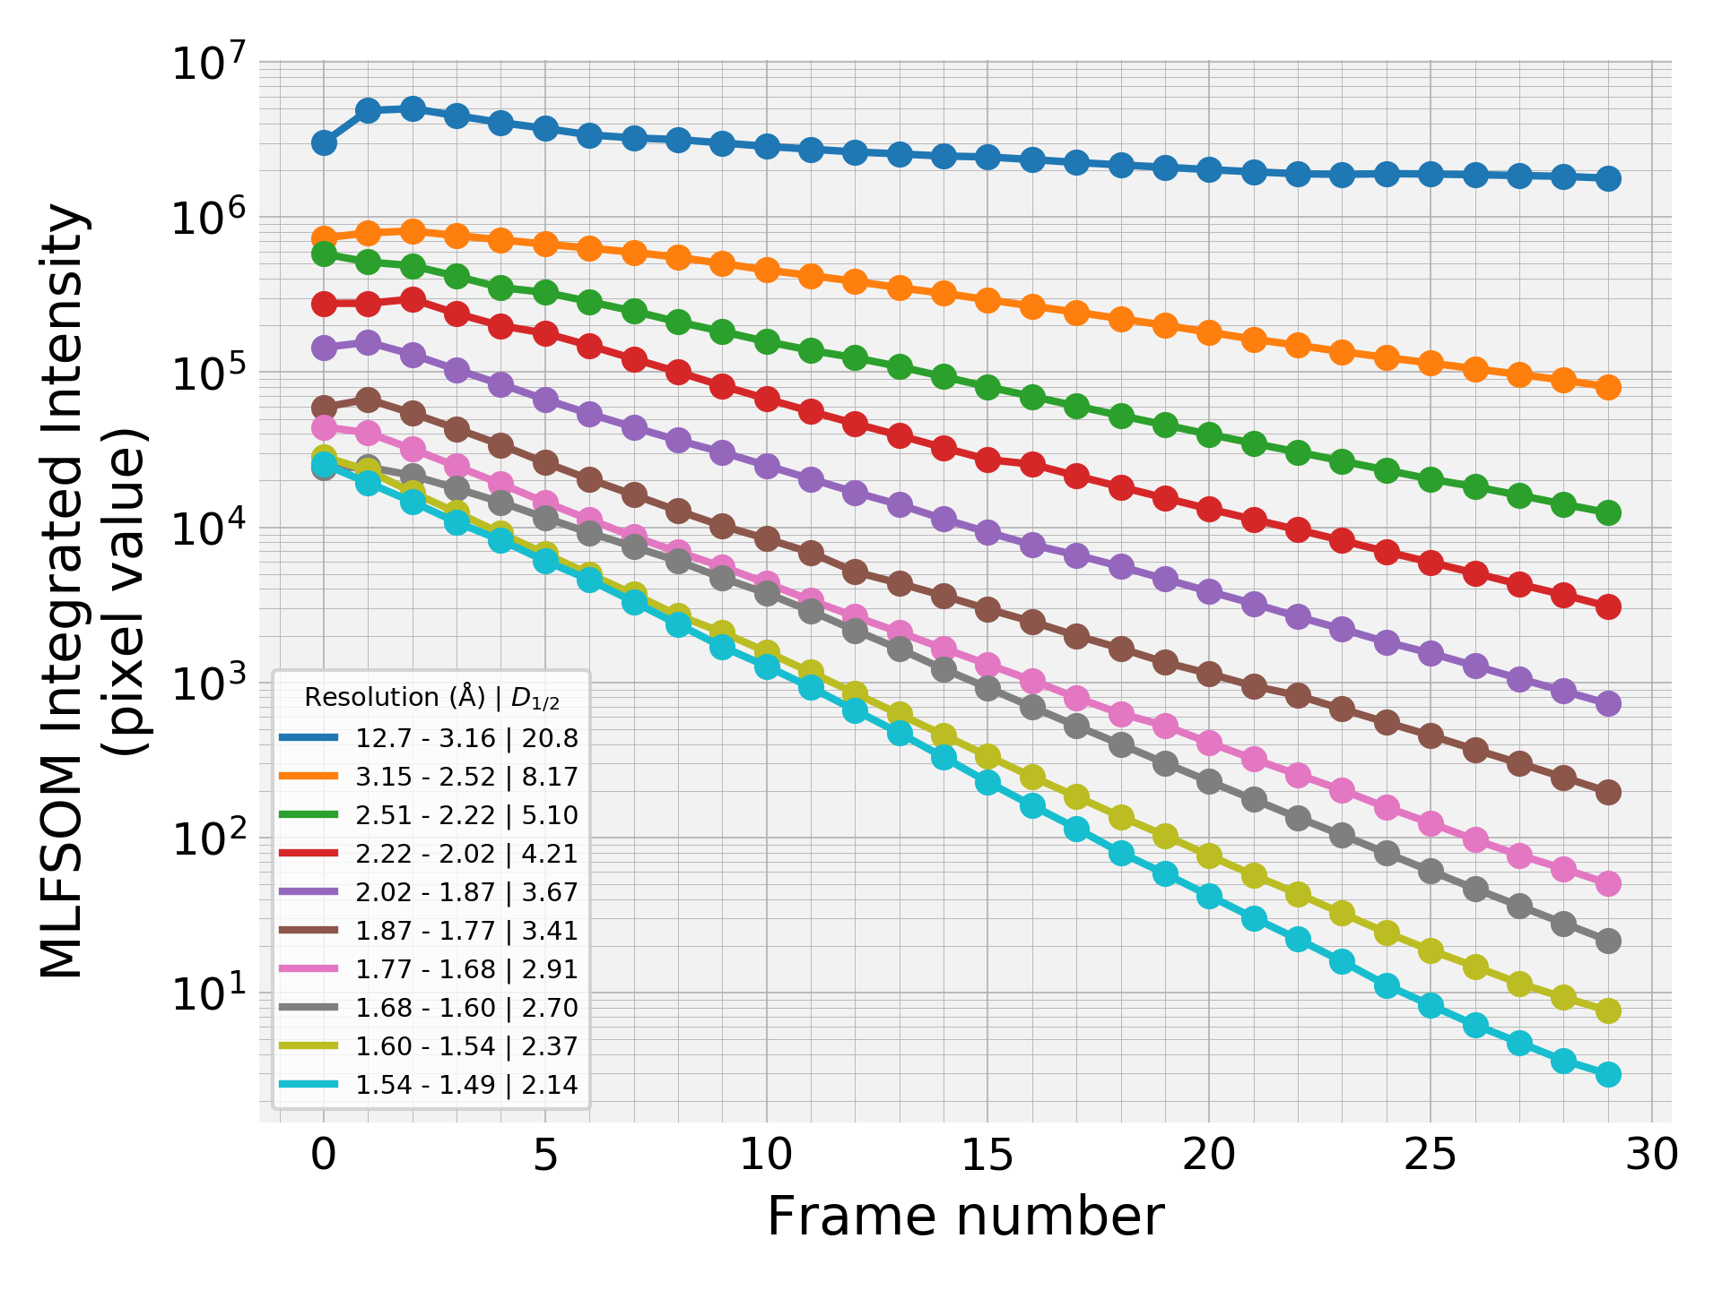
Integrated intensity by resolution shells
Typical curves i.e. decay speed increases with resolution
Initial increase in the intensity is most obvious in the lowest resolution shell

Slide 17
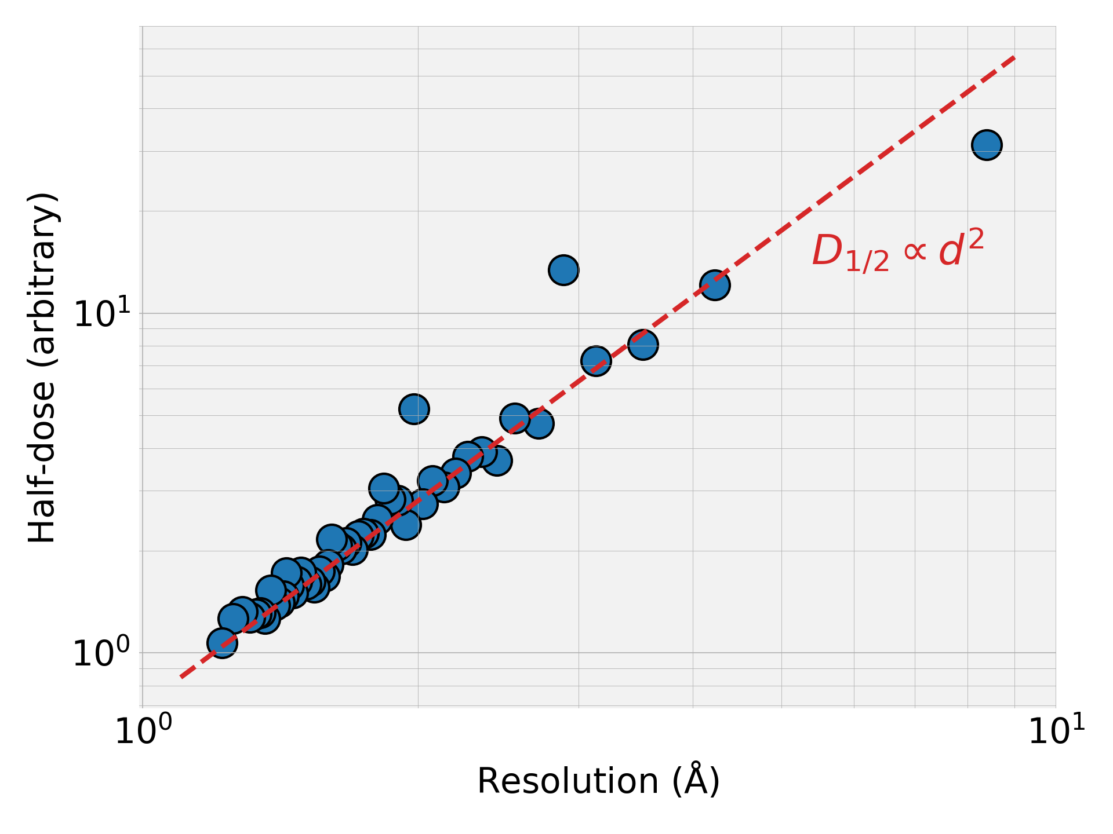
Half-dose vs. resolution
On the right I’m showing the calculated half-dose vs. resolution just like we did in our last paper.
Fitting a power law to the date yielded the best fit exponent of 1.89 – pretty close to 2!

Slide 18
FEW OBSERVATIONS & NOTES
The integrated intensity does not decrease much between the first and the last frame i.e. only by a factor of ~3.5 despite the dramatic increase in the mosaicity and the B-factor. I expected it to decrease much more than that??? We might need more parameters to model the radiation damage.
Maybe non-uniform change in the mosaicity, B-factor and unit cell plays a much bigger role than I thought in the first place.

Slide 19
COMING VERY SOON…
I’m running the scripts to the same things using Gaussian beam
I’ve been working on Peter’s script to run Gaussian beam for a while, I needed to correct some errors in the homogeneous beam case. And complete the missing functions to run Gaussian beam case. Only a few things left to be done.
Regarding the running time, the new iMac runs the script as much as 10x faster than the old iMac I’m using. So, once I make the script run, it won’t take more than a day to run even in the case of the Gaussian beam.

